Slide 1
CSE 519: Data Science
Steven Skiena
Stony Brook University
Lecture 7: Data Cleaning

Slide 2
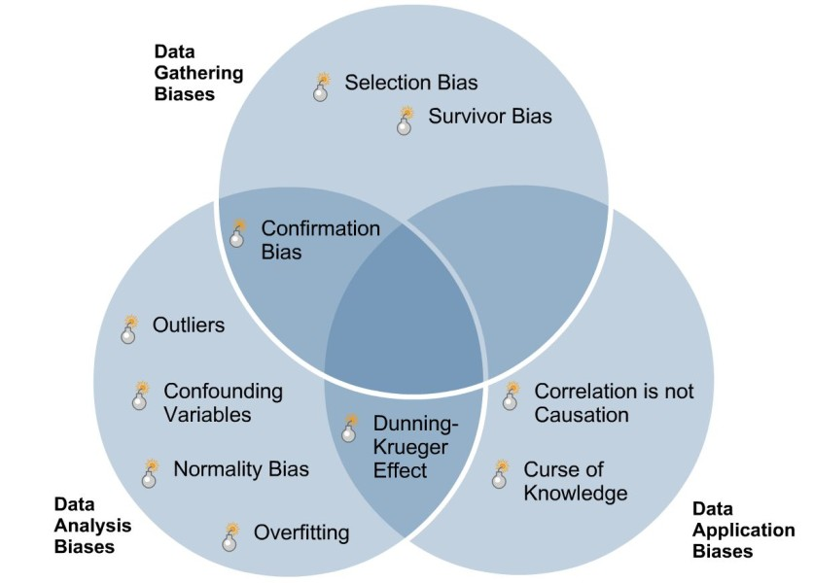
Biases in Sampling and Analysis
Data bias occurs when data is inaccurate, incomplete, or missing, which can lead to an inaccurate representation of a population.
The best way to clean data is to eliminate systematic biases in data collection.

Slide 3
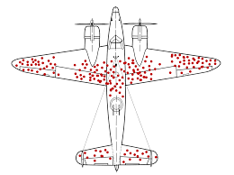
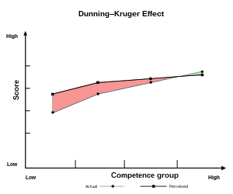
Classic Sampling/Analysis Biases
Selection bias – over/under sample certain groups.
Survivor bias – by selecting at the end, you undersample who exits early.
Confirmation bias – people stop sampling / analyzing when the results confirm expectation.
Dunning-Kruger effect – poor performers over-estimate their level of performance

Slide 4
Cleaning Data: Garbage In, Garbage Out
Many issues arise in ensuring the sensible analysis of data from the field, including:
Distinguishing errors from artifacts.
Data compatibility / unification.
Imputation of missing values.
Estimating unobserved (zero) counts.
Outlier detection.

Slide 5
Errors vs. Artifacts
Data errors represent information that is fundamentally lost in acquisition.
Artifacts are systematic problems arising from processing done to data.
The key to detecting artifacts is the sniff test, examining the product closely enough to get a whiff of something bad.

Slide 6
First-time Scientific Authors by Year?
In a bibliographic study, we analyzed PubMed data to identify the year of first publication for the 100,000 most frequently cited authors.
What should the distribution of new top authors by year look like?
It is important to have a preconception of any result to help detect anomalies.

Slide 7
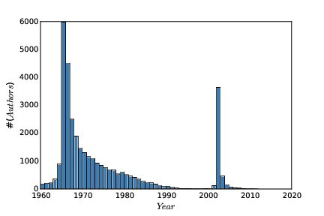
Might this be Right?
A student once tried to foist this off on me.
What artifacts do you see?
What possible explanations could cause them?

Slide 8
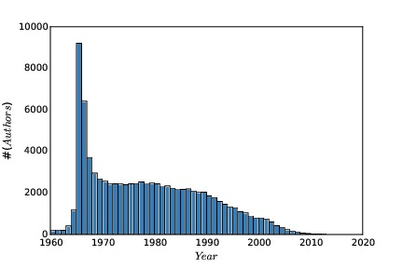
Mystery Solved!
Pubmed used author first names starting in 2002.
SS Skiena became
Steven S Skiena
Data cleaning gets rid of such artifacts.

Slide 9
Data Compatibility
Data needs to be carefully massaged to make ``apple to apple’’ comparisons:
Unit conversions
Number / character code representations
Name unification
Time/date unification
Financial unification

Slide 10
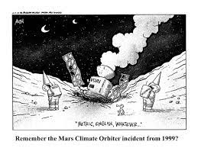
Unit Conversions
NASA’s Mars Climate Orbiter exploded in 1999 due to a metric-to-English conversion issue.
Even sticking to the metric system has potential inconsistencies: cm, m, km?
Bimodal distributions can indicate trouble
Z-scores are dimensionless quantities.
Vigilance in data integration is essential.

Slide 11
Normalization and Z-scores
It is critical to normalize different variables to make their range/distribution comparable.
Z-scores are computed:
Z-scores of height measured in inches is the same as height measured in miles.
Your biggest analysis sins will come in using unnormalized variables for analysis!

Slide 12
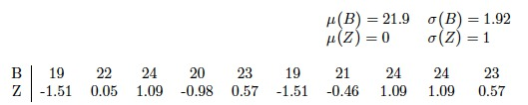
Z-score Examples
Z-scores have mean 0 and sigma=1.
Thus Z-scores of different variables are of comparable magnitude.
The sign identifies if it is above/below the mean.

Slide 13

Number / Character Representations
The Ariane 5 rocket exploded in 1996 due to a bad 64-bit float to 16-bit integer conversion.
Measurements should be decimal numbers
Counts should be integers.
Fractional quantities should be decimal, not (q,r) like (pounds,oz) or (feet,inches).

Slide 14
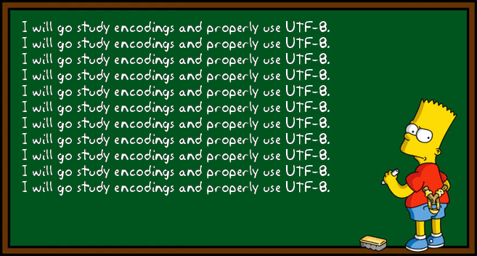
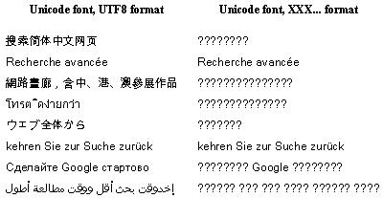
Character Representations
A particularly nasty cleaning issue in textual data is unifying character code representations:
ISO 8859-1 is a single byte code for ASCII
UTF-8 is a multibyte encoding for all Unicode characters.
Notes:
http://perltricks.com/article/building-a-utf-8-encoder-in-perl/

Slide 15
Name Unification
I appear on the web as: (Steve|Steven|Stephen|S.) (S.|Sol|_) (Skiena|Skeina|Skienna)
Use simple transformations to unify names, like lower case, removing middle names, etc.
Consider phonetic hashing methods like Soundex and Metaphone.
Tradeoff between false positives and negatives.

Slide 16
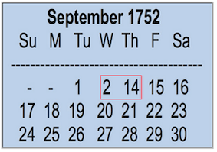
Time / Date Unification
Aligning temporal events from
different datasets/systems can be problematic.
Use Coordinated Universal Time (UTC), a modern standard subsuming GMT.
Financial time series are tricky because of weekends and holidays: how do you correlate stock prices and temperatures?

Slide 17

Financial Unification
Currency conversion uses exchange rates.
Correct stock prices for splits and dividends.
Use returns / percentage change instead of absolute price changes.
The time value of money needs correction for inflation for fair long-term comparisons.
Why do stock/oil prices correlate over 30 years?

Slide 18

Dealing with Missing Data
An important aspect of data cleaning is properly representing missing data:
What is the year of death of a living person?
What about a field left blank or filled with an obviously outlandish value?
The frequency of events too rare to see?
Setting such values to zero is generally wrong

Slide 19
Imputing Missing Values
With enough training data, one might drop all records with missing values, but we may want to use the model on records with missing fields
Often it is better to estimate or impute missing values instead of leaving them blank.
A good guess for your death year is birth+80.

Slide 20
Imputation Methods
Mean value imputation - leaves mean same.
Random value imputation - repeatedly selecting random values permits statistical evaluation of the impact of imputation.
Imputation by interpolation - using linear regression to predict missing values works well if few fields are missing per record.

Slide 21
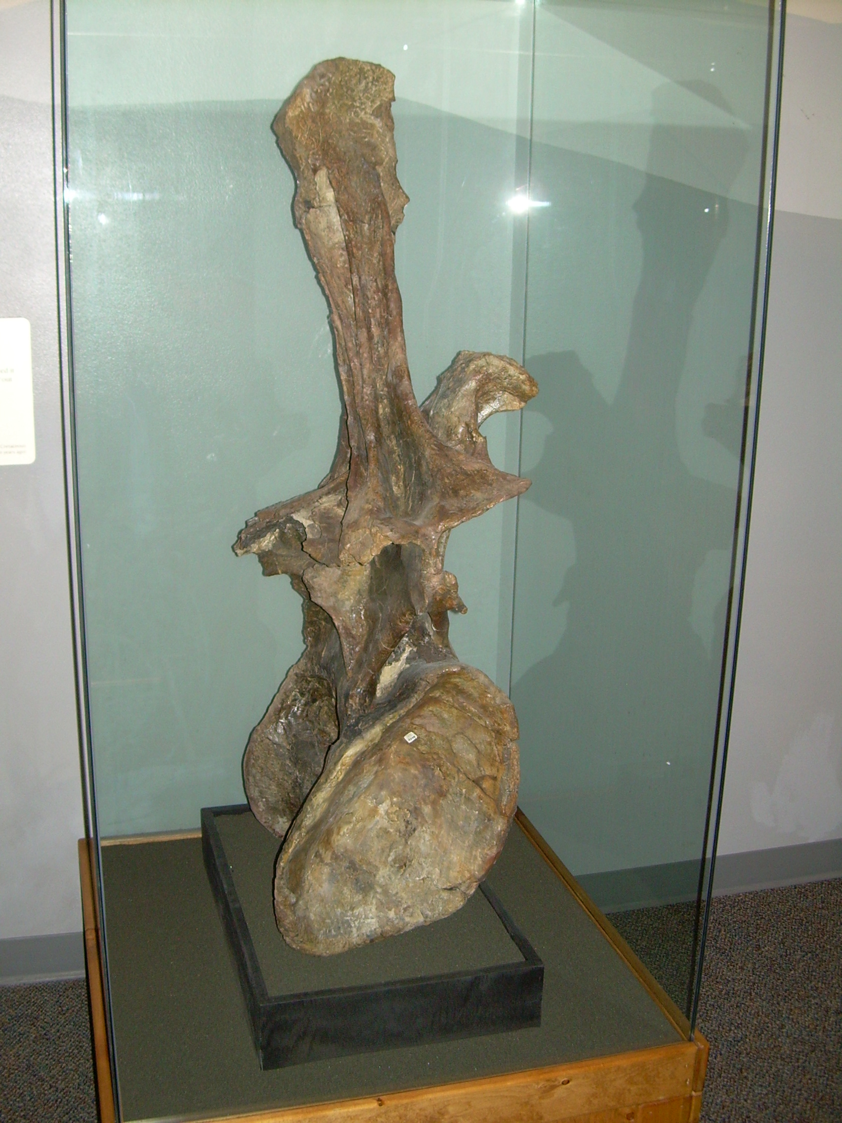
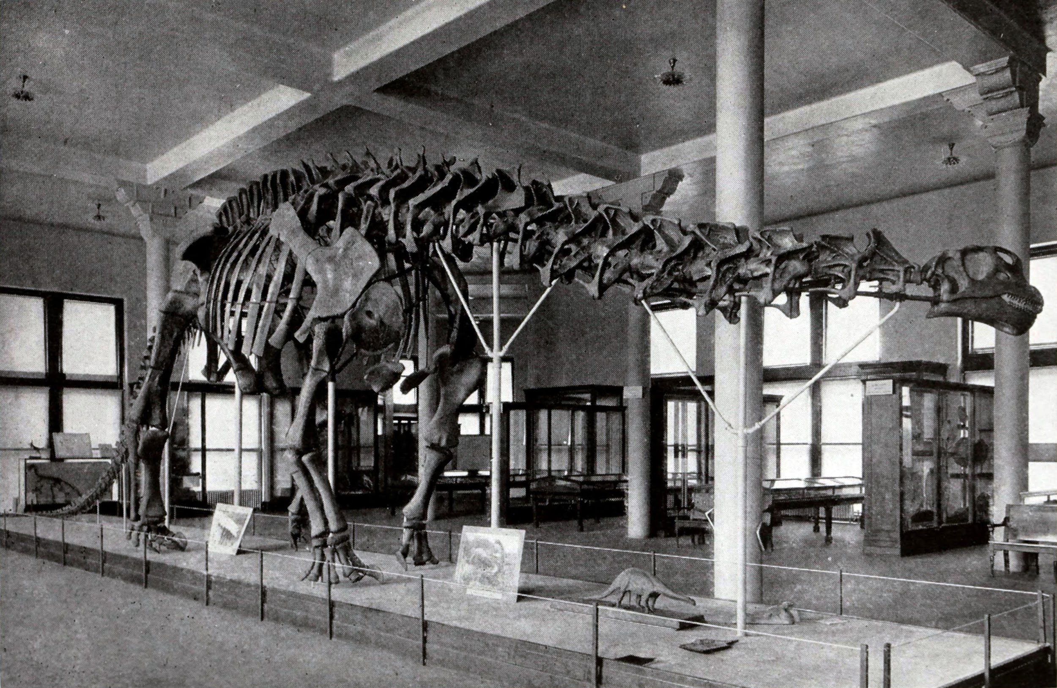
Outlier Detection
The largest reported dinosaur vertebra is 50% larger than all others: presumably a data error.
Look critically at the maximum and minimum values for all variables.
Normally distributed data should not have large outliers, k sigma from the mean.
Fix why you have an outlier. Don’t just delete.

Slide 22
Detecting Outliers
Visually, it is easy to detect outliers, but only in low dimensional spaces.
It can be thought of as an unsupervised learning problem, like clustering.
Points which are far from their cluster center are good candidates for outliers

Slide 23
Delete Outliers Prior to Fitting?
Deleting outliers prior to fitting can yield better models, e.g. if these points correspond to measurement error.
Deleting outliers prior to fitting can yield worse models, e.g. if you are simply deleting points which are not explained by your simple model.

